Slide 1
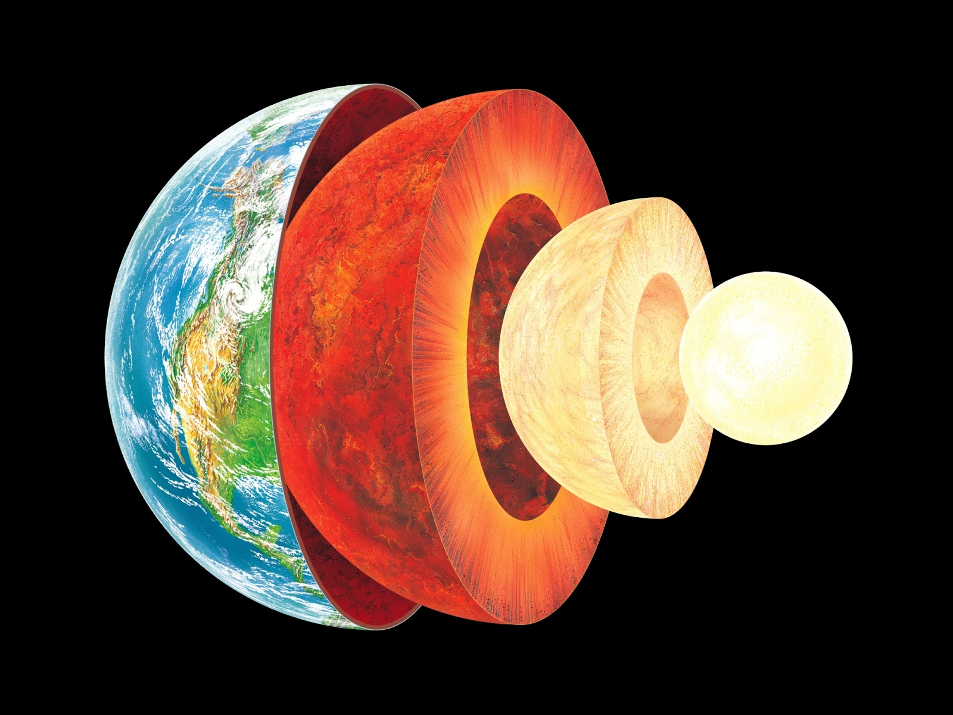
Layers of the Earth

Slide 2

Success Criteria
I can describe the structure of the Earth’s interior.
Outline why it is important to learn about the layers of the Earth.
Identify the layers of the Earth and label them on a diagram.

Slide 3
Essential Question: How are layers of the Earth different from one another?
Think – Pair – Share

Slide 4
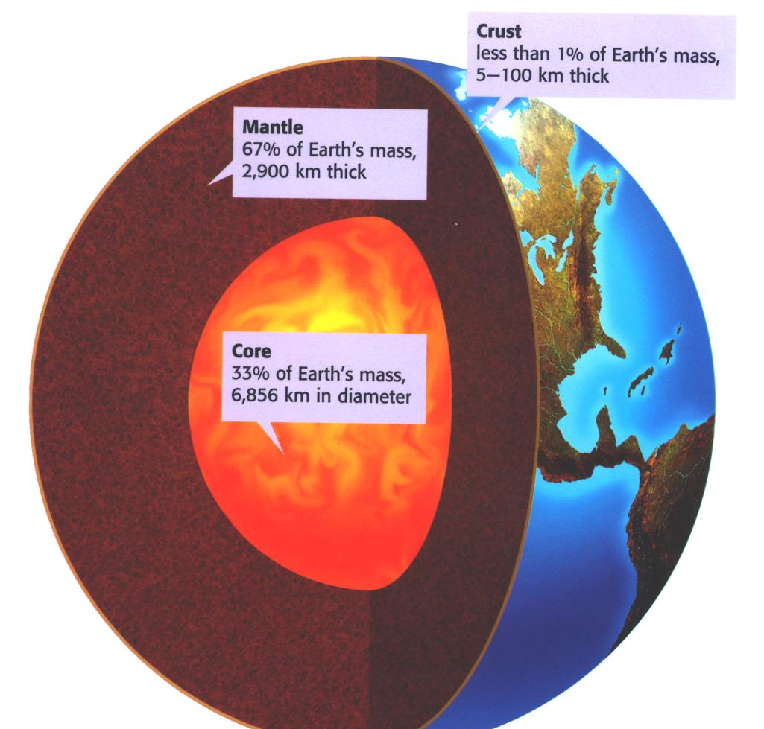
The Earth is made up of 3 main layers:
Crust
Mantle
Core

Slide 5
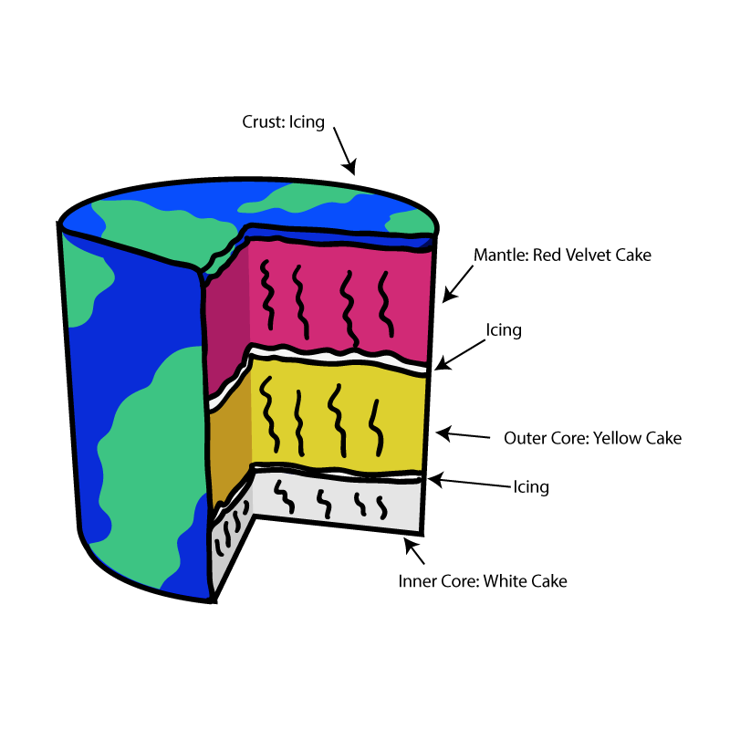
Think of the layers of the Earth like the layers of a cake.

Slide 6
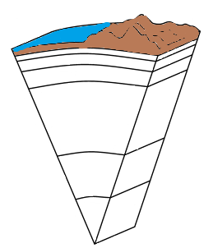
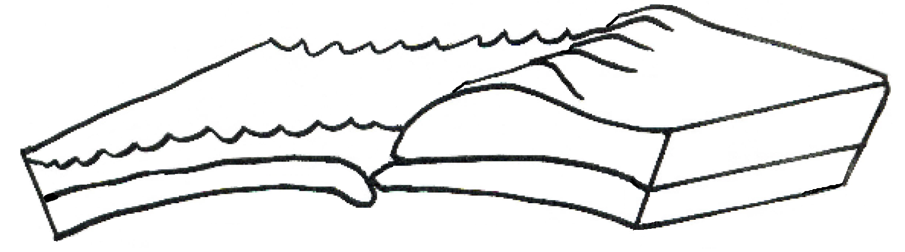
Crust
Ocean
Land
Oceanic Crust
Continental Crust

Slide 7

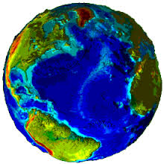
The Earth’s crust is like the skin of an apple.

Slide 8
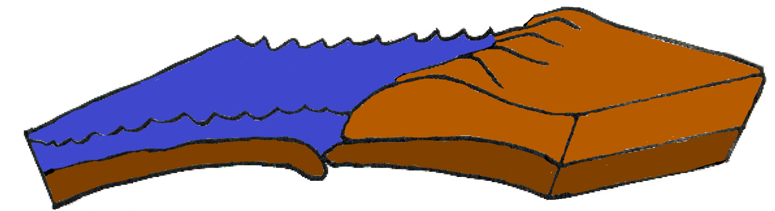
Crust
Ocean
Land
Oceanic Crust
Oceanic Crust
Continental Crust
Continental Crust
Thinnest layer of the Earth
Made up of large amounts of silicon and aluminum
Composed of tectonic plates on which the continents and oceans rest. These “ride” over molten mantle.
Crust is part of the lithosphere.
Two types of Crust: Oceanic and Continental
Notes:
In depth teaching about the plates and their movement will occur in the next essential question

Slide 9
Continental vs. Oceanic Crust
Category | Continental | Oceanic
Rock Type | Granite | Basalt
Thickness | 5 – 70km (Thicker) | 3 – 8 km (Thinner)
State | Solid | Solid
Crust Age | 4 billion years old or Older | 180 million years old or Younger
Density | Less Dense | More Dense
Element Composition | Oxygen, Sodium, Silicon, Aluminum, Potassium | Iron, Magnesium, Calcium

Slide 10
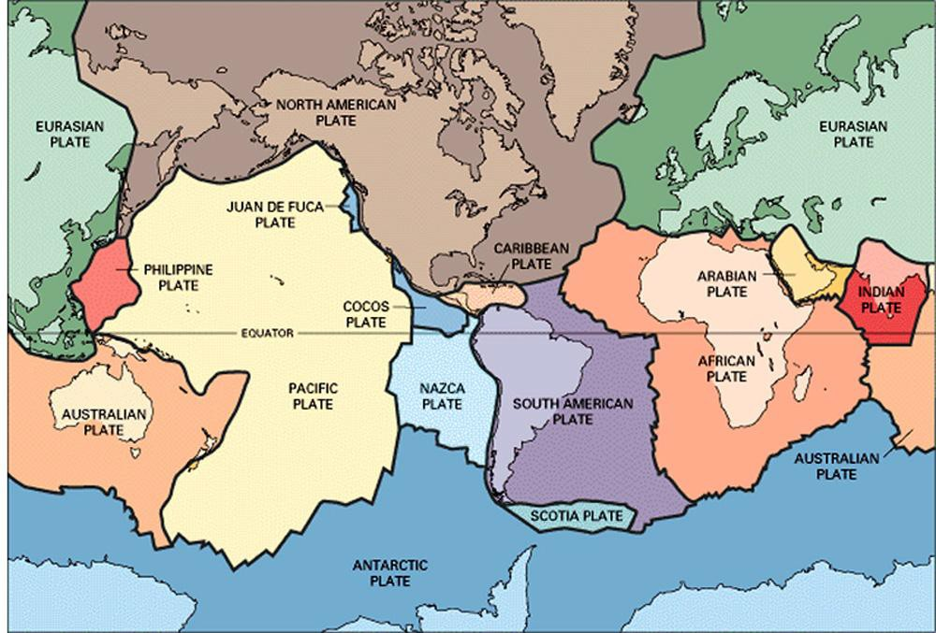
The Lithospheric Plates
The crust of the Earth is broken into many pieces called plates. The plates "float" on the soft, semi-rigid Mantle (asthenosphere).

Slide 11
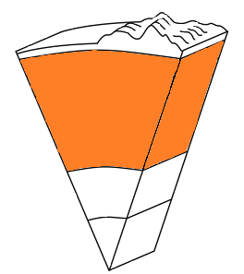
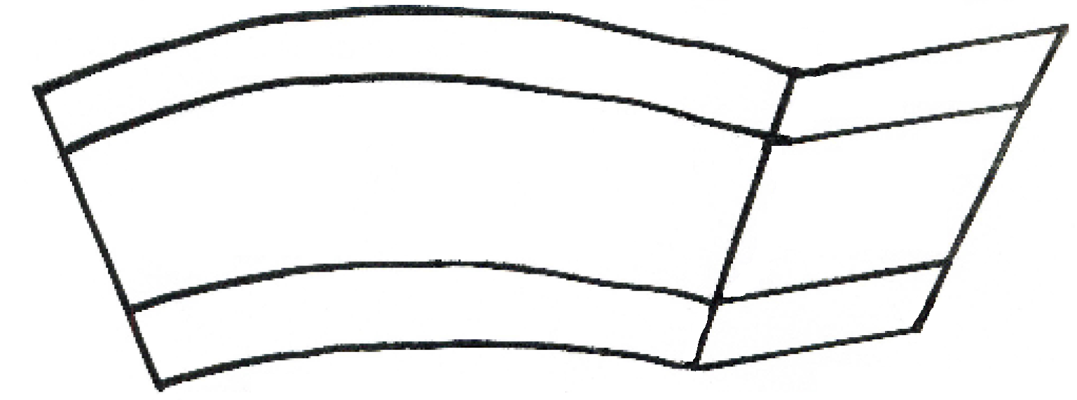

Mantle
Middle Mantle
Upper Mantle
Convection Currents
Lower Mantle

Slide 12
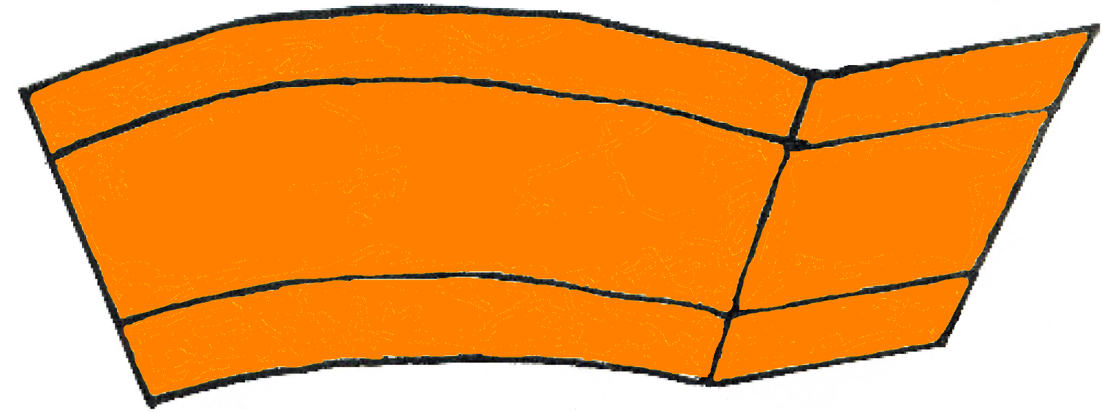
Mantle
Upper Mantle
Convection Currents
Middle Mantle
Lower Mantle
Solid but capable of flow (like fudge) Semi-Solid/Semi Liquid
Thickest layer of the Earth 2900km (1800 miles)
Element Composition: Magnesium, Silicon, Oxygen, and Iron
The hot magma rises then cools and sinks.
These convection currents cause changes in the Earth’s surface.
Conveyor belt for the tectonic plates.
Notes:
The movement of the lithospheric plates and the convection currents will be covered more in-depth during the next essential question.

Slide 13
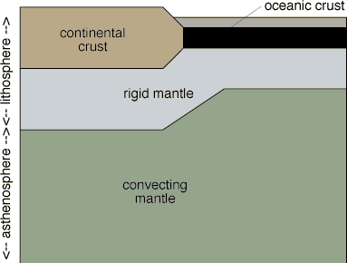
The Asthenosphere
The asthenosphere is the semi-rigid part of the middle mantle that flows like hot asphalt under a heavy weight.

Slide 14
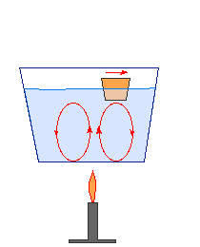
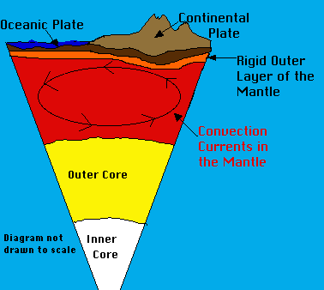
Convection Currents
The middle mantle "flows" because of convection currents. Convection currents are caused by the very hot material at the deepest part of the mantle rising being less dense, then cooling becoming more dense and sinking again --repeating this cycle over and over.

Slide 15
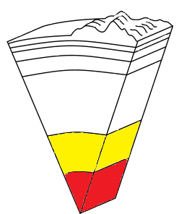

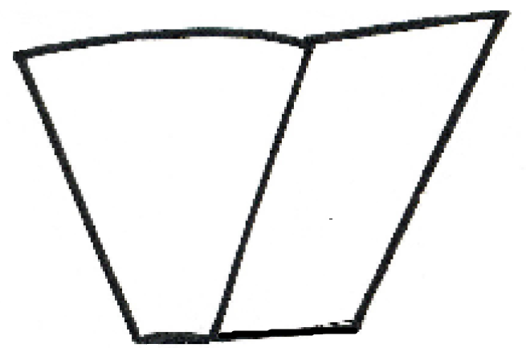
Core
Outer Core
Inner Core

Slide 16
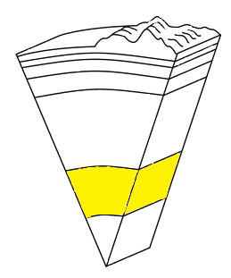

Outer Core
Composition: Molten (liquid) metal that is about 4,700°C (8,500°F)
Thickness: 2,266 km (1,400) miles
State of Matter: Composed of the melted metals nickel and iron (liquid)
Located about 1,800 miles beneath the crust.

Slide 17

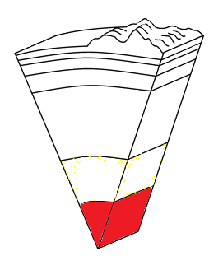
Inner Core
Solid sphere made mostly of iron and has Nickel
It is believed to be as hot as 6,650°C (12,000°F)
Heat in the core generated by the radioactive decay of uranium and other elements
It is solid because of the pressure from the outer core, mantle, and crust compressing it.
Thickness: 1271 km (800 miles)

Slide 18
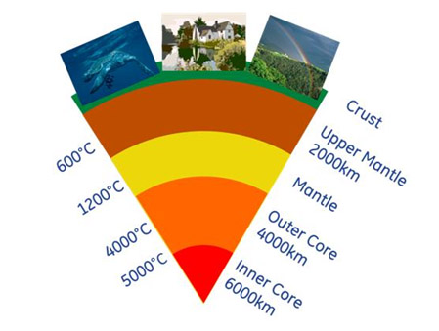
Temperature increases as depth increases

Slide 19
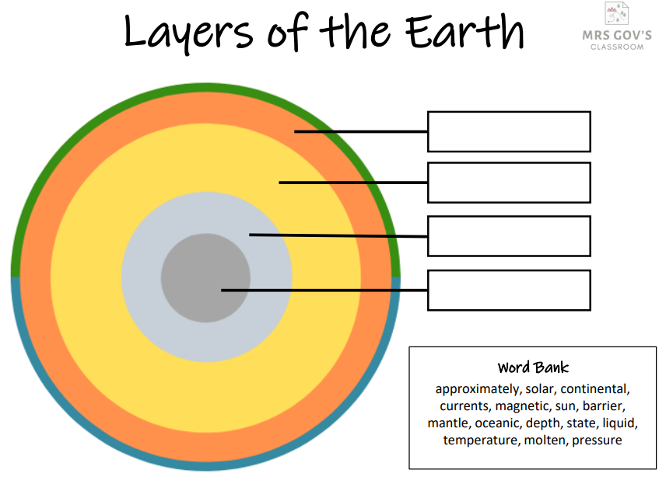

Slide 20
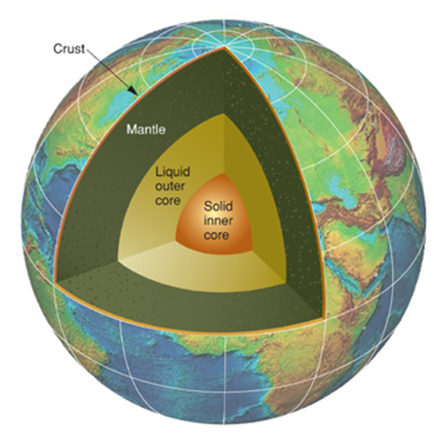
Earth’s Layers Rap
https://youtu.be/HOd7PRJMkkQ

